Slide 1
SAGE Spring 2020 Final Report
Sandy Zhao

Slide 2
Overview
Puzzles:
challenges
Conditional Puzzles
Sequence Puzzle changes
Puzzle instructions
SAGE tutorials
Solution to the Warm up phase guidance
Changes to the surveys
Completed work for field studies
Future Work

Slide 3
Challenges for conditional puzzles
Building simple or manageable Boolean statements inside if statements
Using simple Booleans in understandable ways for the audience
Building puzzles with the limited Boolean options
The way instructions are organized and delivered

Slide 4
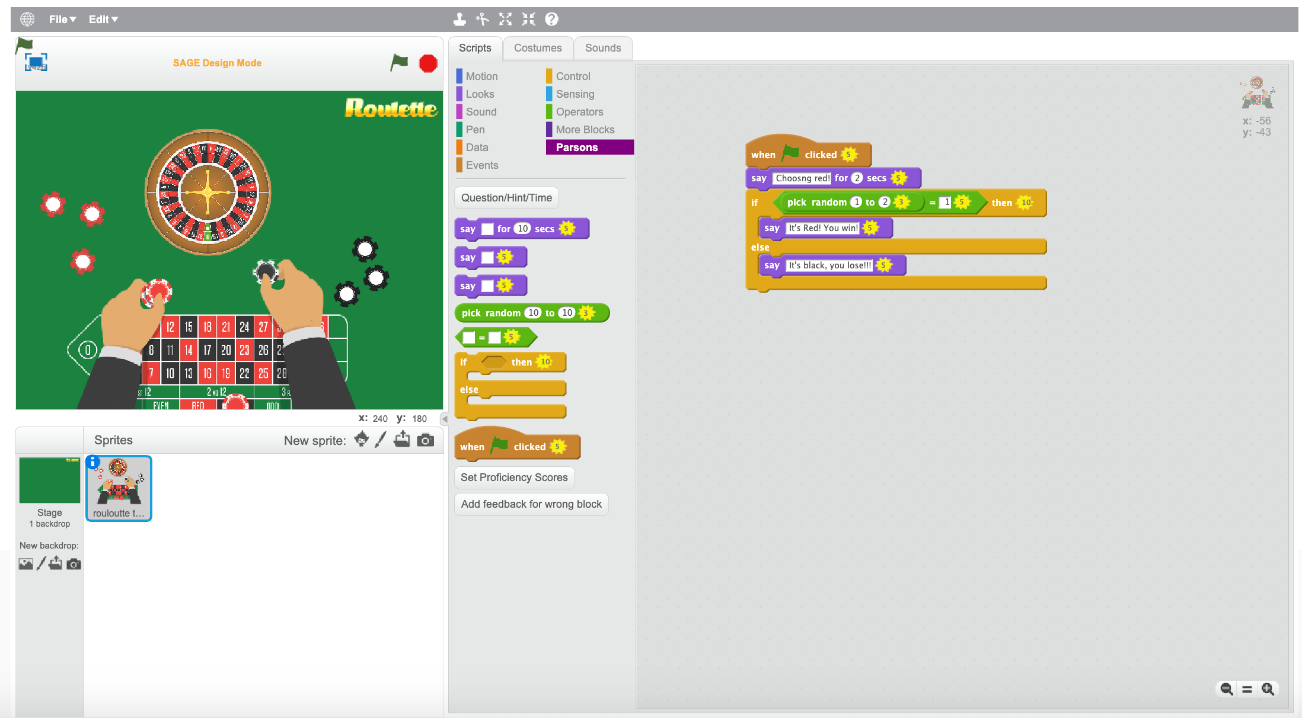
Conditional puzzles: Warm up

Slide 5
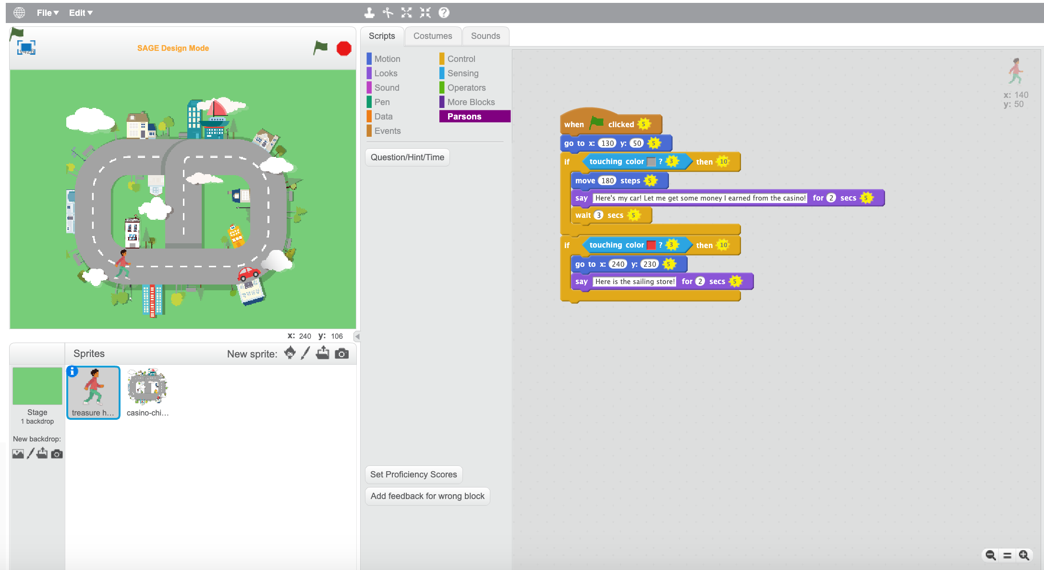
Conditional puzzles: Shopping for supplies

Slide 6
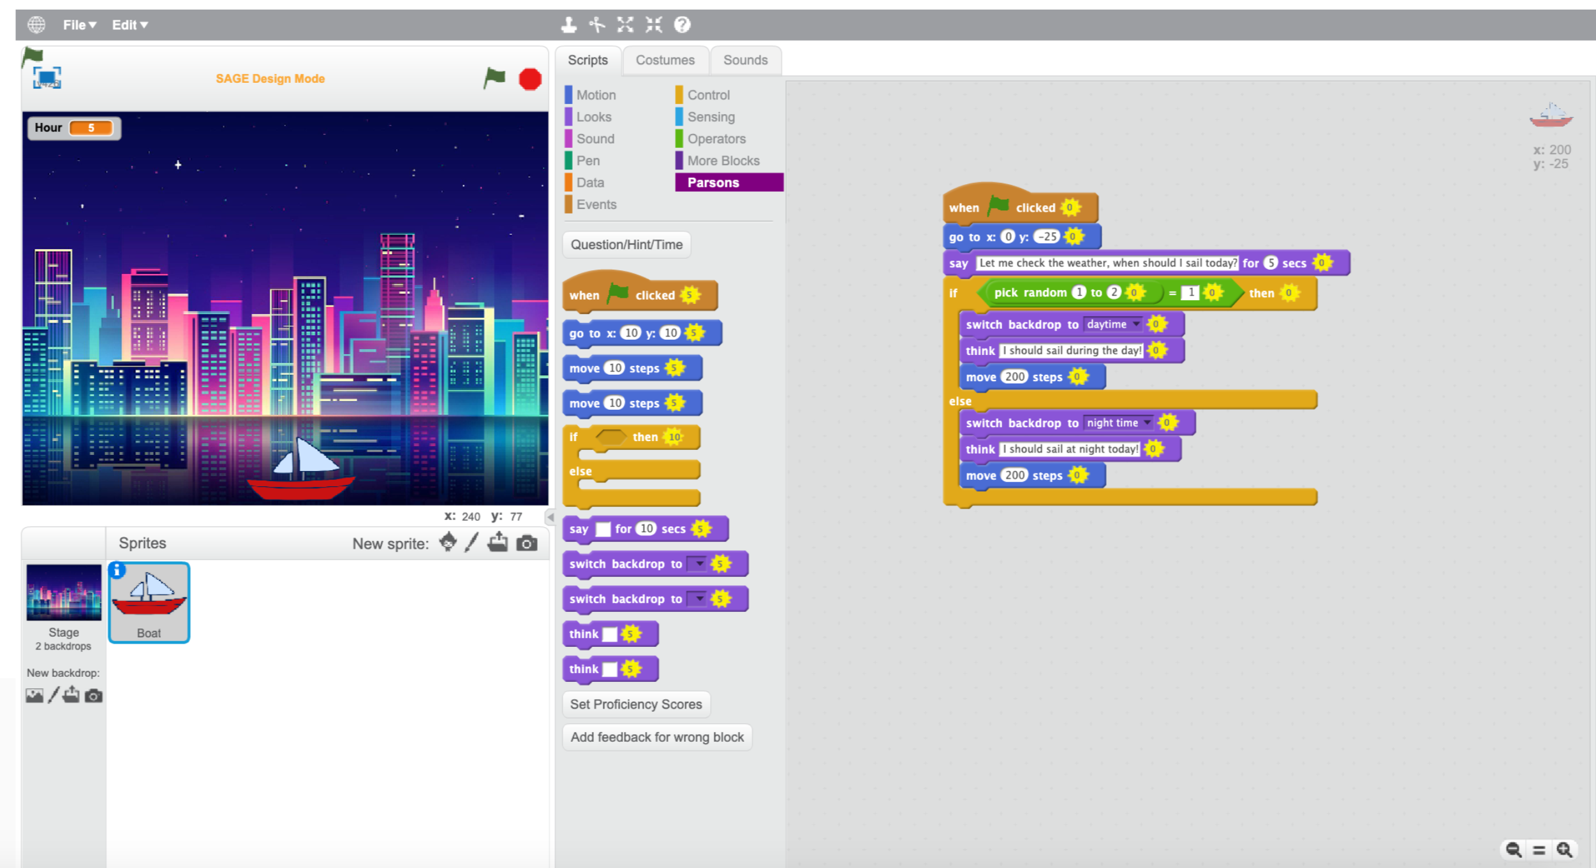
Conditional puzzles: When to sail today?

Slide 7
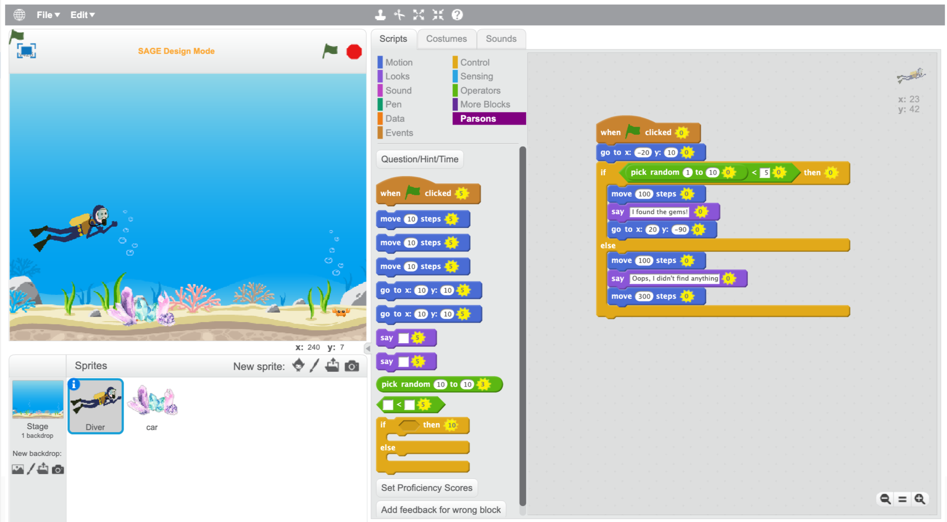
Conditional puzzles: Finding gem in the Ocean

Slide 8
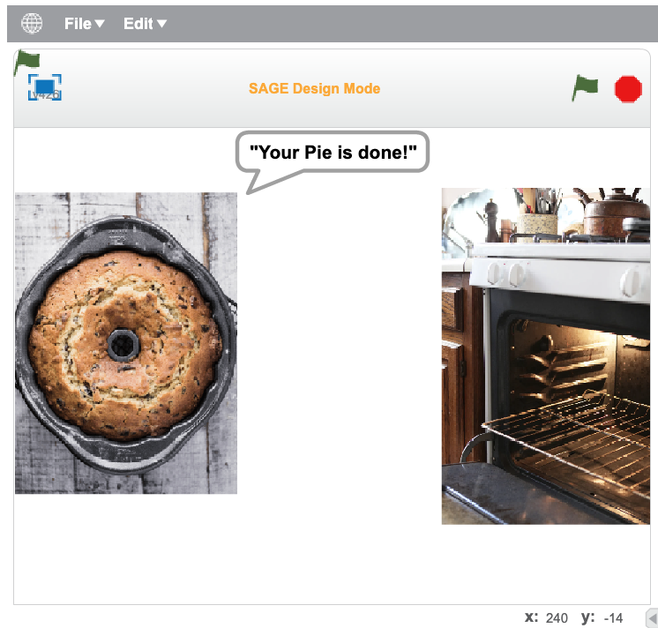
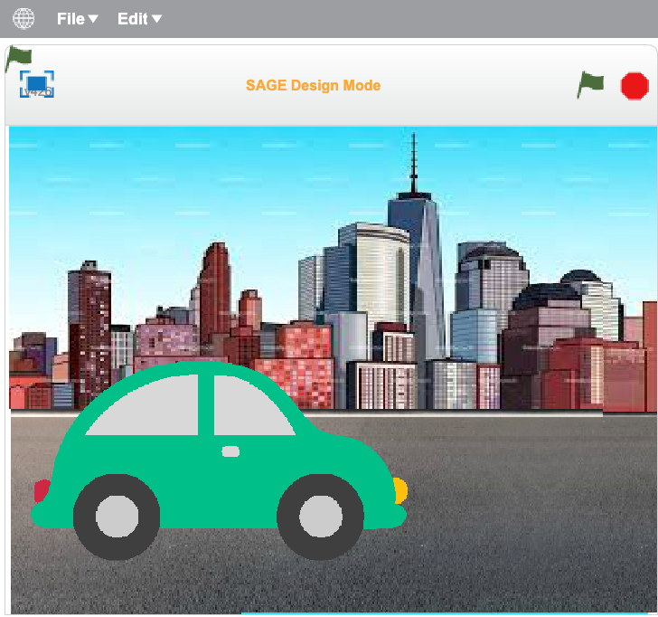
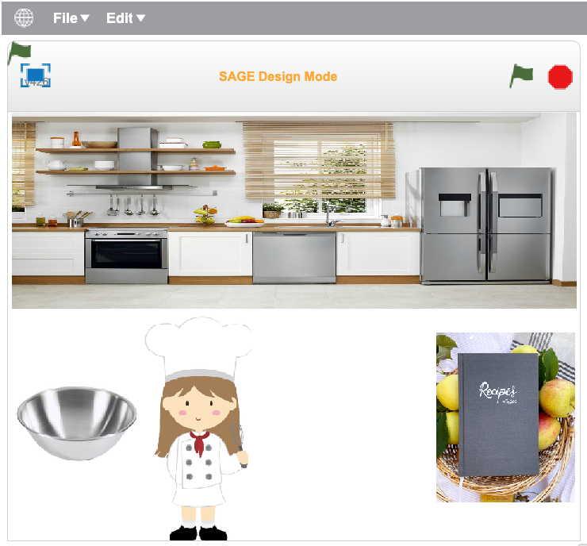
Sequence puzzles changes
The instruction of each puzzle are also adjusted accordingly for the adult version.

Slide 9
Links for all puzzle instructions
For sequence puzzles: https://docs.google.com/document/d/139eK6bk0F_QqfOHggdh2ivNJeJJ2jo3YIXHYrk8INqo/edit?usp=sharing
Total number of blocks used: 6+16+14+5=41
For conditional puzzles: https://docs.google.com/document/d/1qHXO-HQKW_IqzxYSlKJArARohkSjhgyXbpIcyswgD8c/edit?usp=sharing
Total number of blocks used: 7+11+10+11=39

Slide 10
Newly recorded tutorials
A video recording of a PowerPoint tutorial
Goes through how to use the SAGE website and also go through the sequence concept
Provides three examples for them to get a sense of puzzle solving
Link: https://columbia.hosted.panopto.com/Panopto/Pages/Viewer.aspx?id=55ce84bb-c317-4d84-8074-abbb00a89892

Slide 11
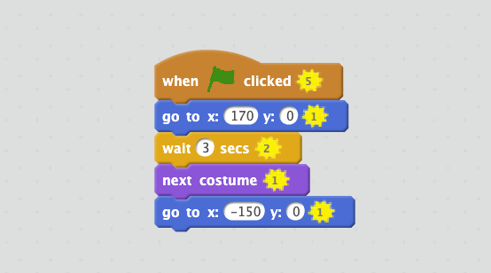
Warm up phase solution will be provided on MTurk
Links: https://docs.google.com/document/d/1d5U5TMPwwSIRf2VvE8pfOIwlnfUw3ge6Xpk-wSDYi8A/edit?usp=sharing
https://docs.google.com/document/d/1aq6_rhD-WNYgfGUgPPQMdILRysp_3JP_OmpP8_1Aocc/edit?usp=sharing

Slide 12
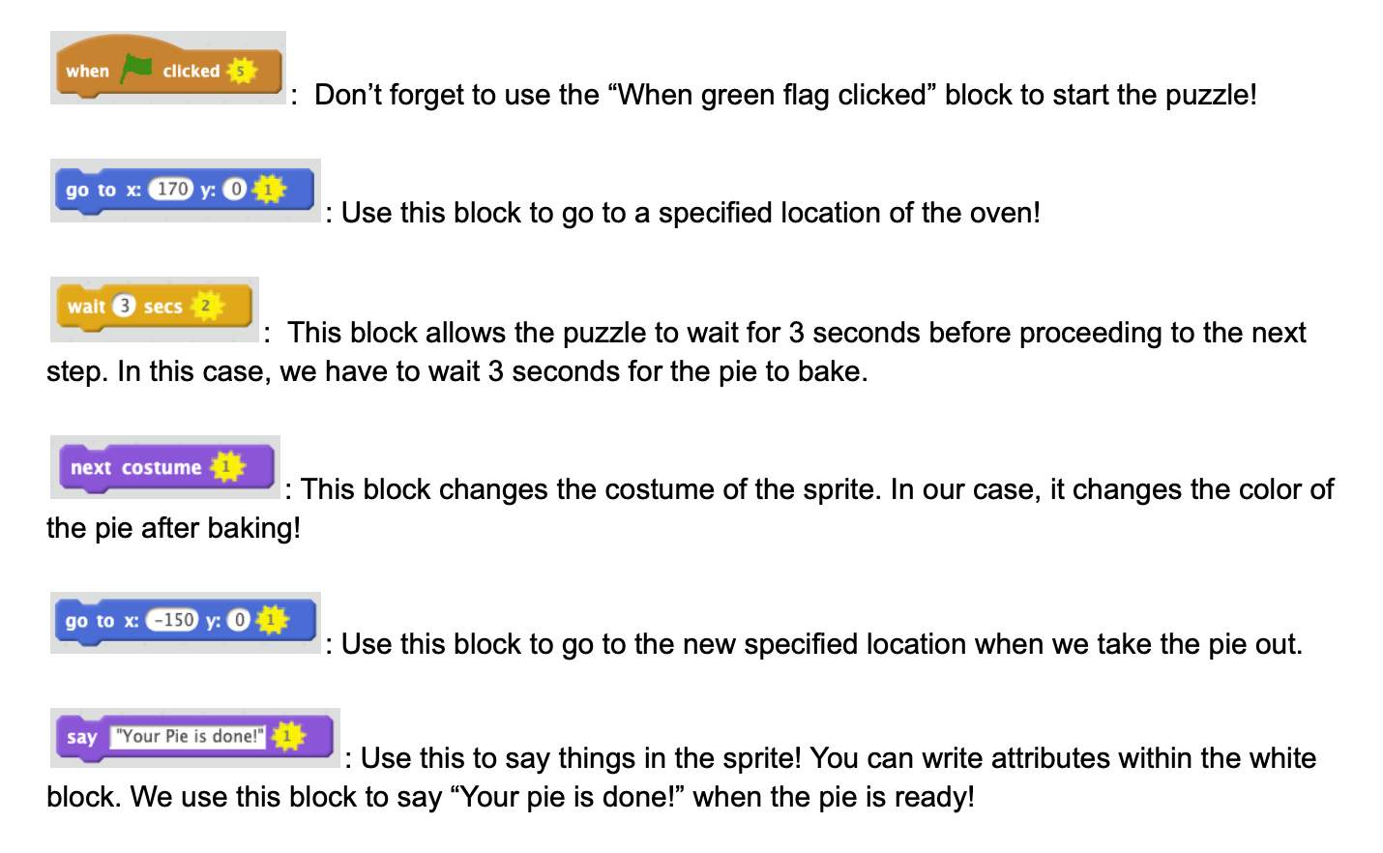
And each block will have a corresponding explanation

Slide 13
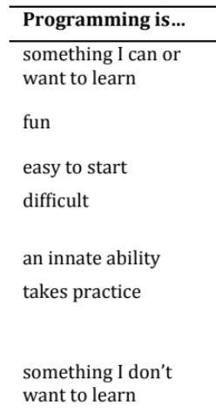
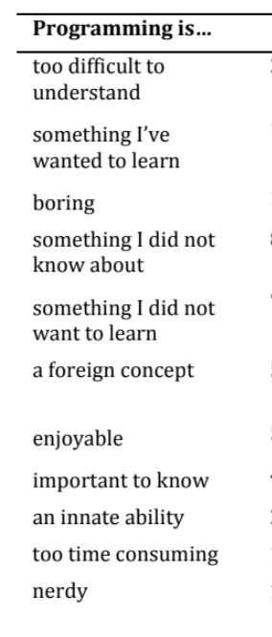
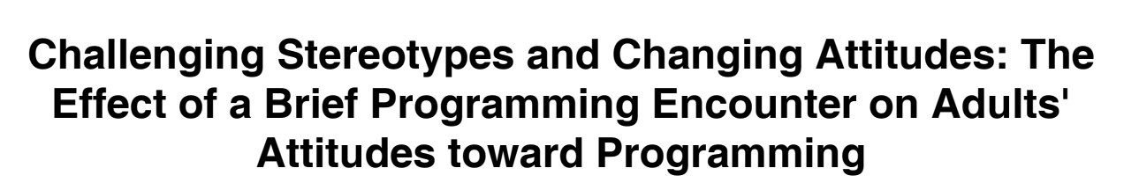
Survey changes…
Corrected the surveys to better fit the adult persona
Background survey and Intrinsic motivation survey
Add questions that evaluates the before and after opinions of the subjects on programming

Slide 14
What we already have for our field studies
For middle school students:
Background Survey
Pre and post Test
Cognitive Load Survey
Teacher User Guide
Puzzle Instructions
Need some additional conditionals instructions
SAGE Sequence Tutorial Slides
SAGE Sequence puzzles
SAGE Conditional puzzle
Still need a warm up puzzle
For adults:
Background Survey
Pre and post Test
Cognitive Load Survey
Teacher User Guide
Puzzle Instructions
Need to see if the conditionals instructions are effective
SAGE Sequence Tutorial Slides + recording
Warm up phase explanations and solutions(for sequence and conditionals)
SAGE Sequence puzzles
SAGE Conditional puzzle

Slide 15
Future work…
Possible summer collaboration with Outreach Engineering
Test out the Mturk environment and evaluate results generated
Then, can adjust the difficulty level of surveys and puzzles accordingly
Follow up with Elissa next Fall
Concerns:
consistent scoring metrics across all puzzles
Instruction URL color not clear on the website

